Slide 1
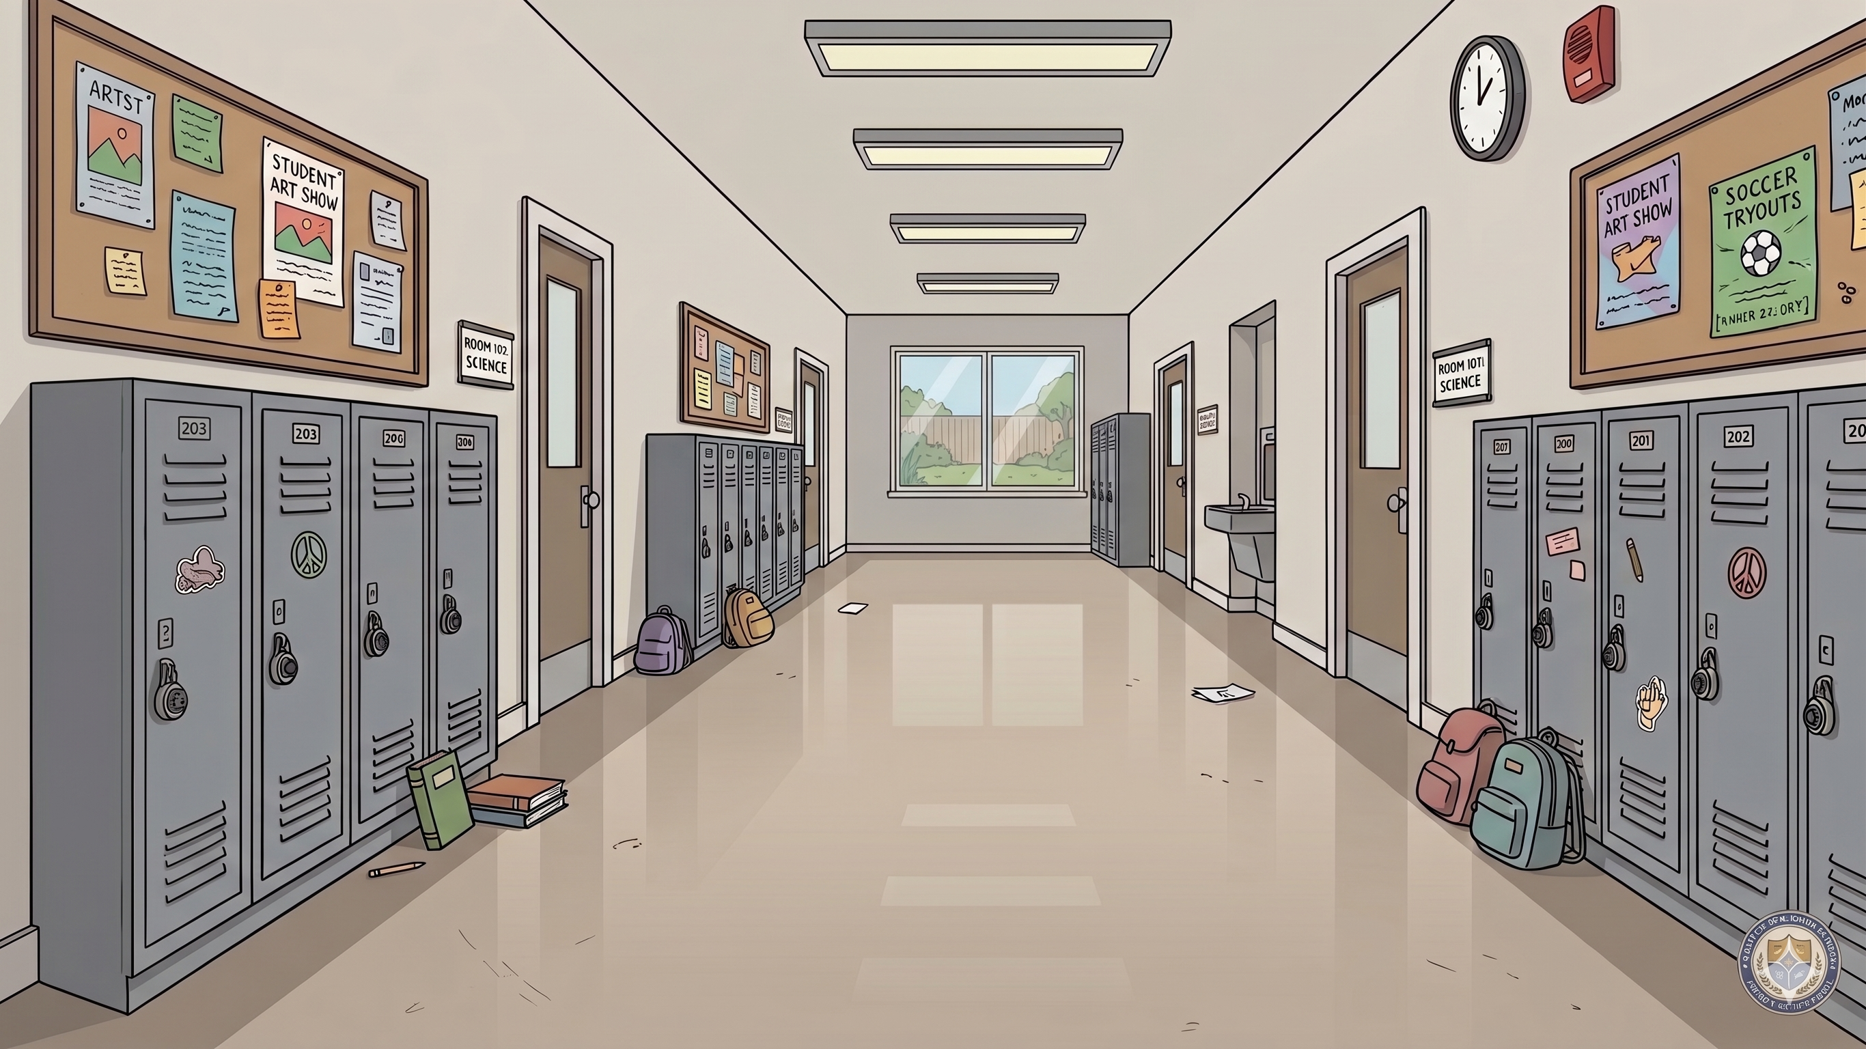
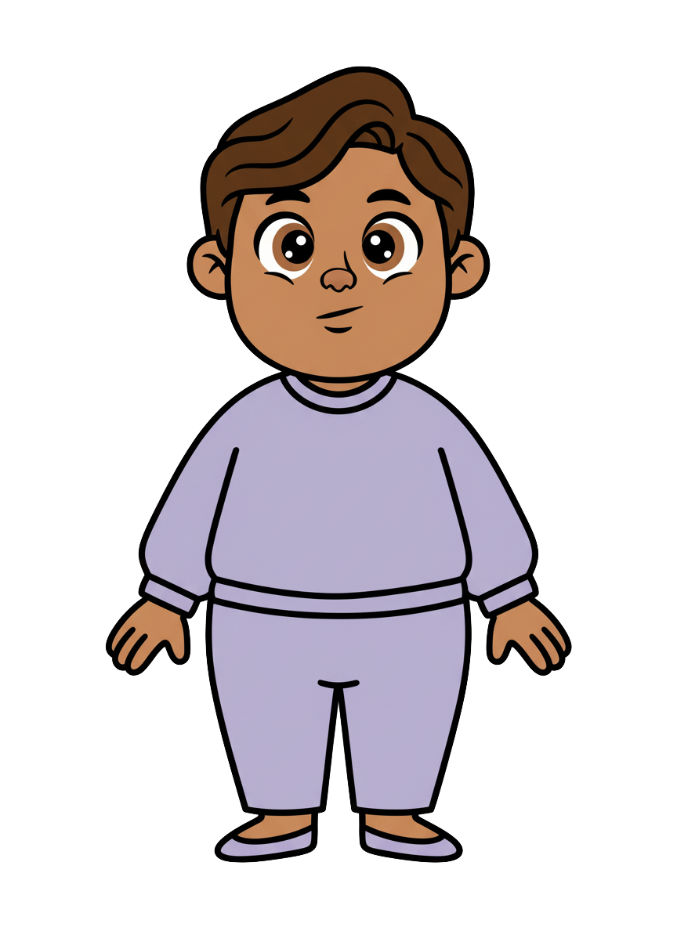
This is Milo

Slide 2
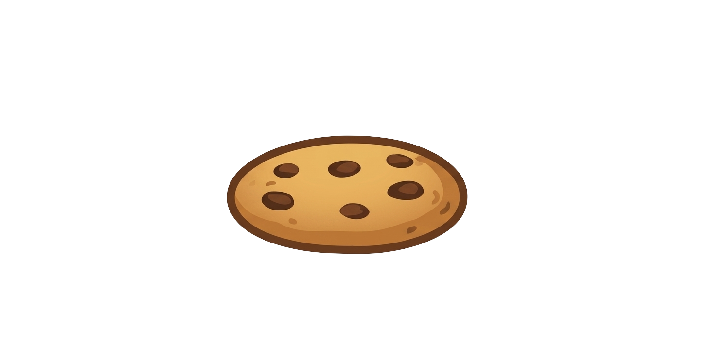
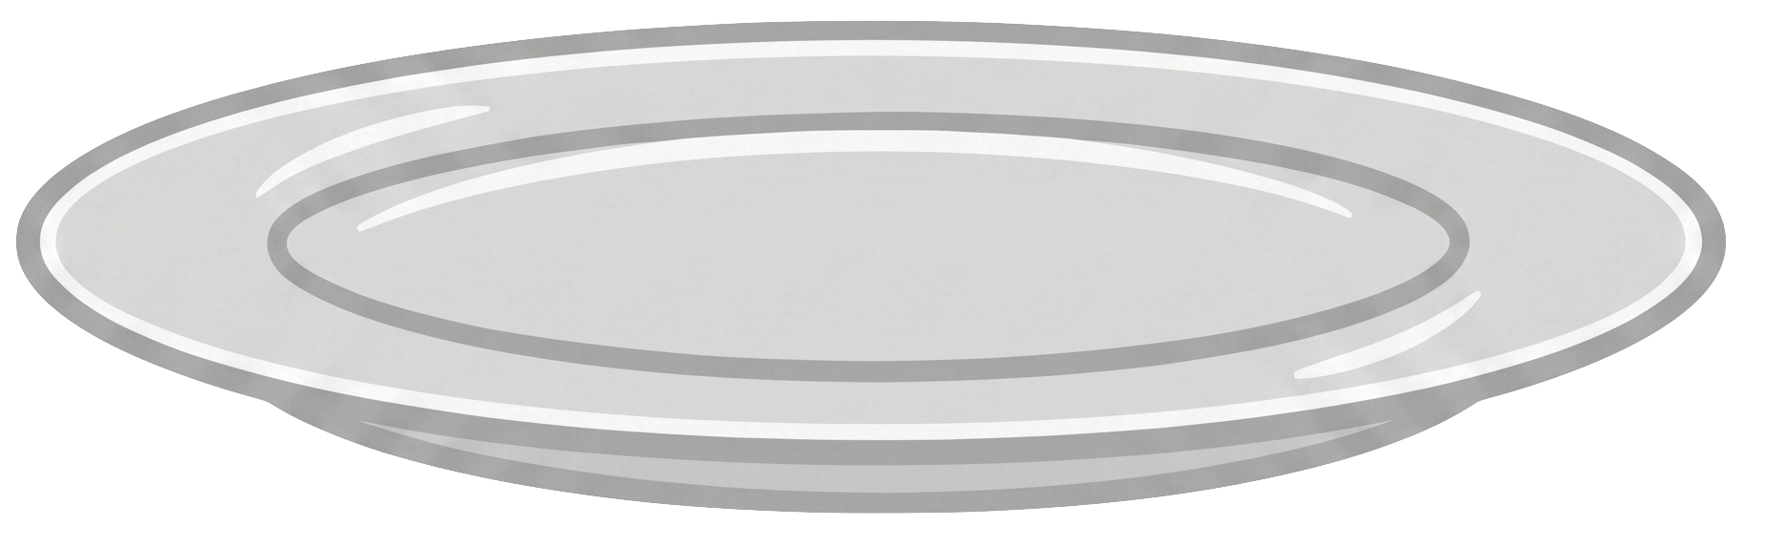
Milo has 5 cookies

Slide 3
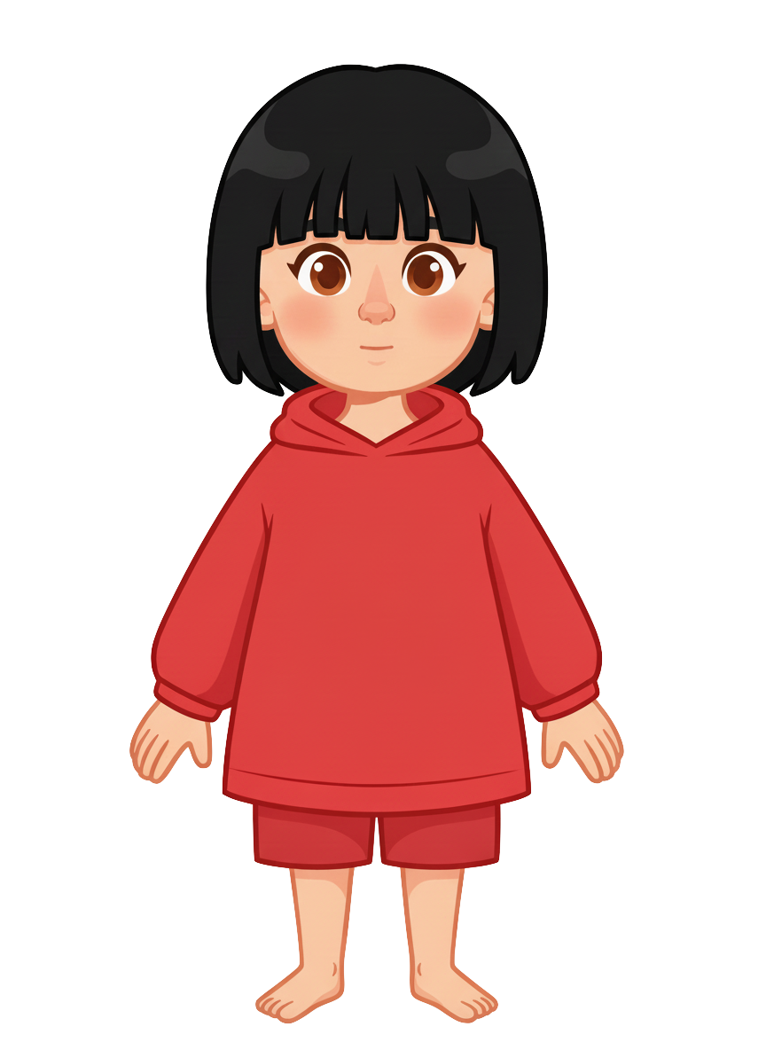
This is Sasha

Slide 4
Sasha has 4 cookies

Slide 5
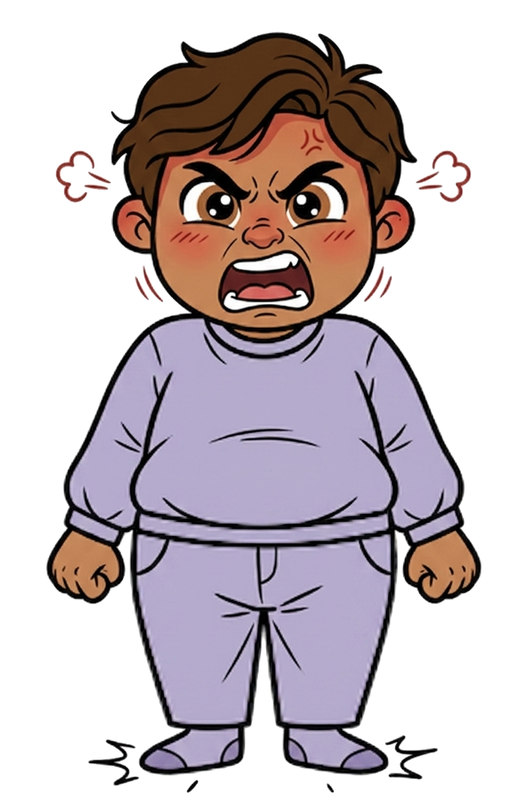
Milo is angry

Slide 6
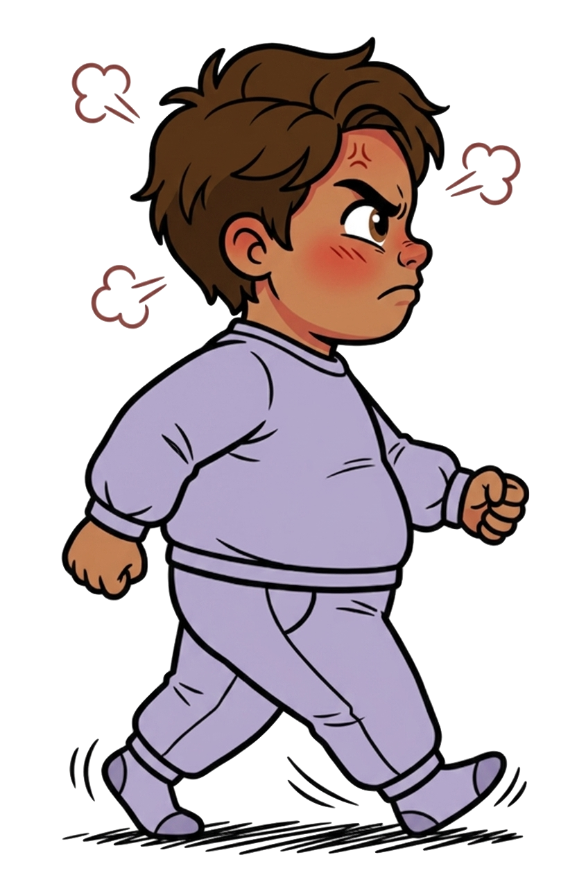
He walks over

Slide 7
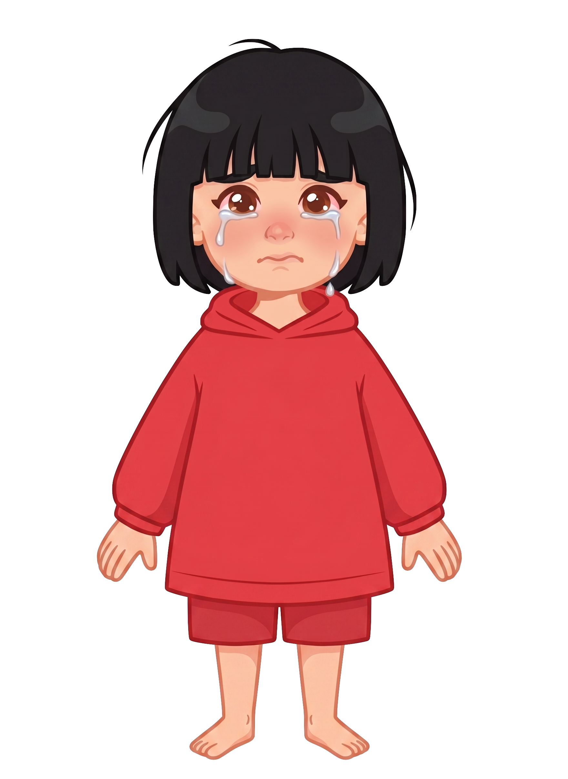
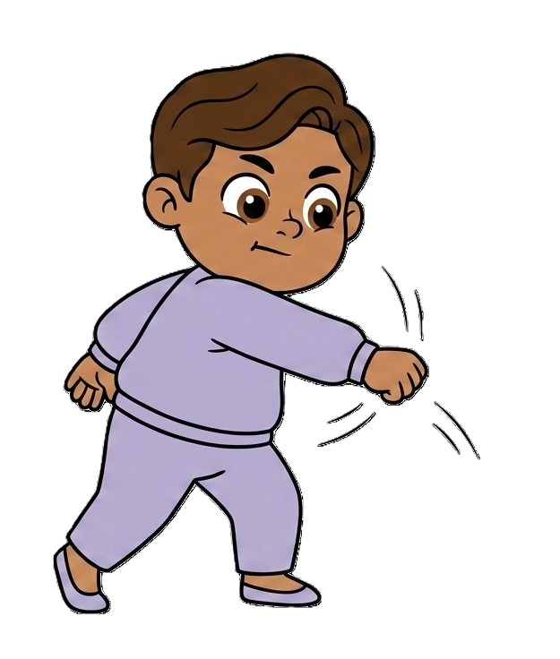
And knocked off 2 of Sasha’s cookies!

Slide 8
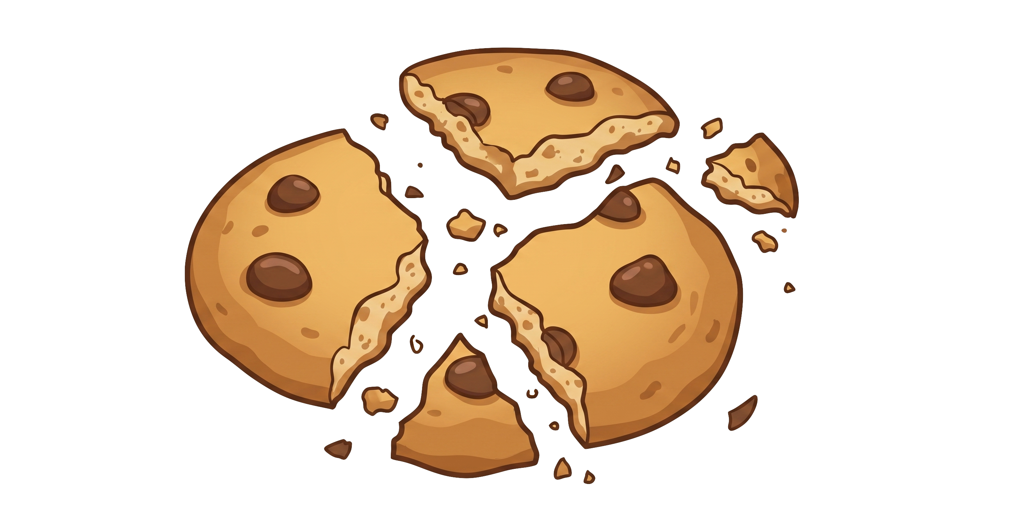
Milo still has 5 cookies. Sasha now has 2 cookies.

Slide 9
Please decide whether you would like to move some of Milo's cookies.

